Slide 1
Face Recognition Algorithm Based on VGG Network Model and SVM
Đào Việt Duy – MSSV:
Nguyễn Duy Hàn Lâm – MSHV: 196005004

Slide 2
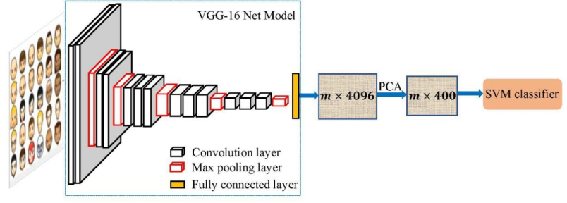
Concept
Nguồn: Hongling Chen, Chen Haoyu, 2019, Face Recognition Algorithm Based on VGG Network Model and SVM.

Slide 3
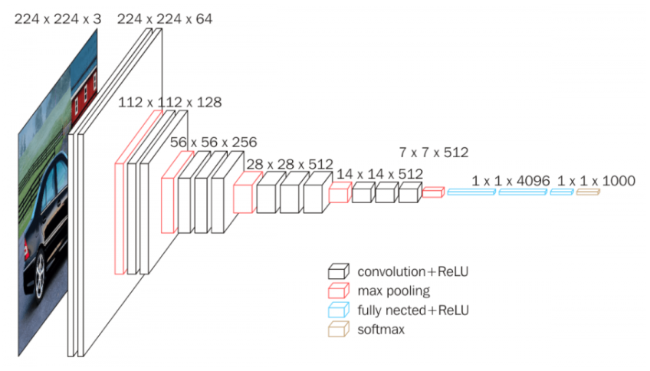
VGG model concept
Nguồn: https://neurohive.io/en/popular-networks/vgg16/

Slide 4
VGG CNN stack
28x28x512
224x224x64
112x112x128
56x56x256
14x14x512

Slide 5
VGG Max-pooling stack
28x28x512
14x14x512
112x112x128
56x56x256
7x7x512

Slide 6
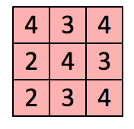
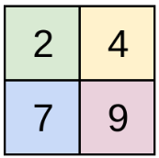

VGG CNN window size
3x3
1x1
2x2
CNN Layer
Max-pooling Layer

Slide 7
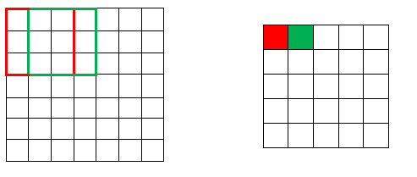
VGG CNN window stride
Window stride = 1

Slide 8
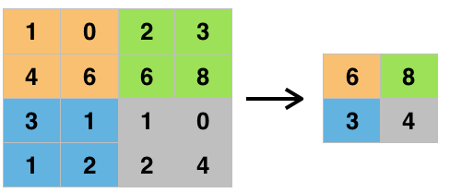
VGG Max-pooling window stride
Window stride = 2

Slide 9
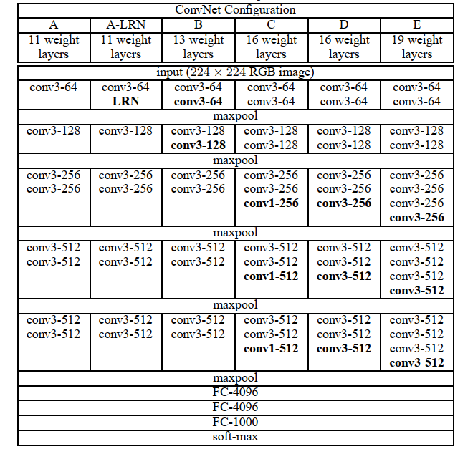
VGG types
Nguồn: Karen Simonyan, Andrew Zisserman, 2015, Very Deep Convolutional Networks For Large-Scale Image Recognition.

Slide 10
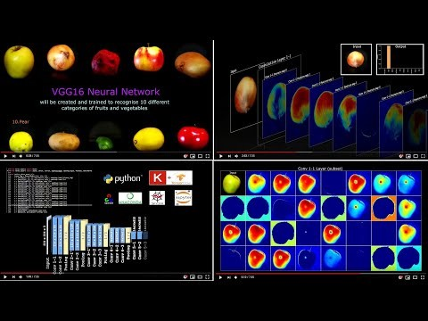
General presentation
Nguồn: https://www.youtube.com/watch?v=RNnKtNrsrmg&ab_channel=DenisDmitriev

Slide 11
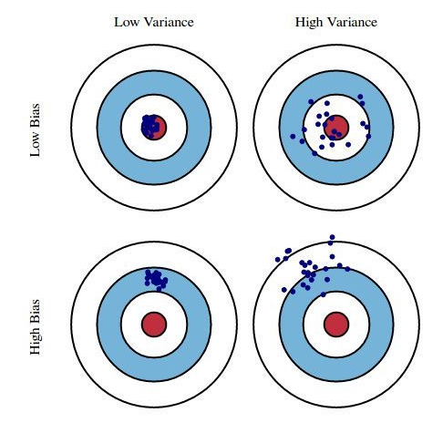
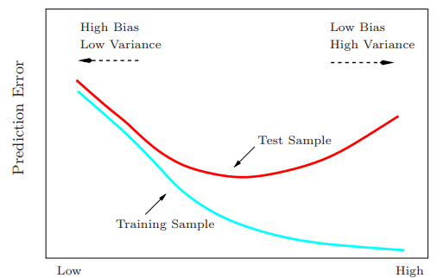
Bias và Variance
Nguồn: Trevor Hastie, Robert Tibshirani, Jerome Friedman, 2008, The Elements of Statistical Learning: Data Mining, Inference, and Prediction (Second Edition).

Slide 12

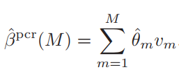
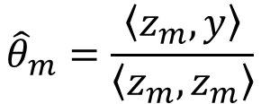
Principle Component Regression
Phân tập dữ liệu thành tập các thành phần z
$${\hat{θ}}_{m}=\frac{\left\langle z_{m},y\right\rangle }{\left\langle z_{m},z_{m}\right\rangle }$$
Chọn tập có m z_component có sai số nhỏ nhất làm mô hình chính.

Slide 13
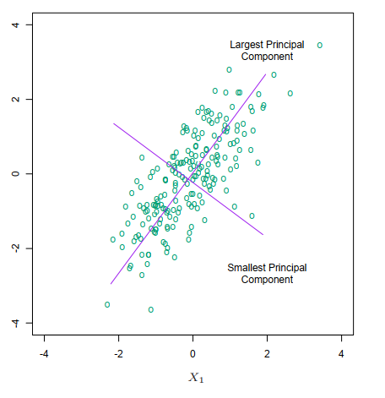
Principle Component Regression
Nguồn: Trevor Hastie, Robert Tibshirani, Jerome Friedman, 2008, The Elements of Statistical Learning: Data Mining, Inference, and Prediction (Second Edition).

Slide 14
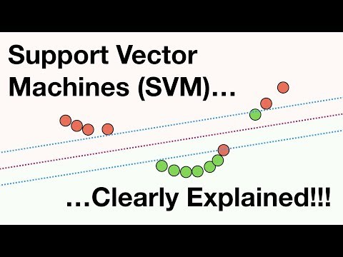
Support Vector Machine - SVM
Nguồn: https://www.youtube.com/watch?v=efR1C6CvhmE&t=723s&ab_channel=StatQuestwithJoshStarmer

